Slide 1
Genetic, Biological And Psychosocial Predictors of Incident and Persistent Internalizing Mental Disorders Among Ugandan Children and Adolescents Living With HIV: A Machine Learning Approach
By
Isaac Okello Opio
(PROGRESS REPORT)

Slide 2





Concept of the Study
CHAKA study
368 cases vs 368 controls
Dr Dickens Akena
Dr. Kalungi Allan
Dr. Jjingo Daudi
Prof. E. Kinyanda
VULNERABILITY
Genetic
-SLC6A4
-TPH2
-FKBP5
-NR3C1
Biological
-Telomere length
-CD4 count
-HIV viral load
-WHO HIV clinical stage
Psychosocial
-Stress
-Social support
-Sociodemographic
PREDICTION: MACHINE LEARNING
Emotional disorders outcomes at 12 months
Source: Own source

Slide 3

Study Aims
Aim 1
Build a machine learning model for prediction of incident and persistent cases of emotional disorders
Aim 2
Evaluate performance of the model for each of genetic, biological and psychosocial factors respectively
Aim 3
Evaluate performance of the model which includes all the three factor domains of genetic, biological and psychosocial factors

Slide 4
Method
01
02
03
Data Cleaning & Feature engineering
Choose algorithm (DT, RF, LR, SVM)
Identify data
05
04
Model Deployment
Train, Validate & Test the model
Source: https://slidesgo.com/

Slide 5
Machine Learning Model Development
Prerequisite
Dataset, Python (v3.11.5) and packages (Pandas), ML framework (pycaret) etc.
Step 1: Data Splitting
Step 2: Model Building (Objective 1)
Supervised ML techniques
Decision trees, random forests, logistic regression, and support vector machines from Pycaret
Step 3: Model Evaluation (Objective 2)
The AUC was computed (also report (precision, recall, and F1 score).
Step 4: Model Integration (Objective 3)
A model using all the three predictors (genetic, biological, and psychosocial factors) will be constructed.

Slide 6
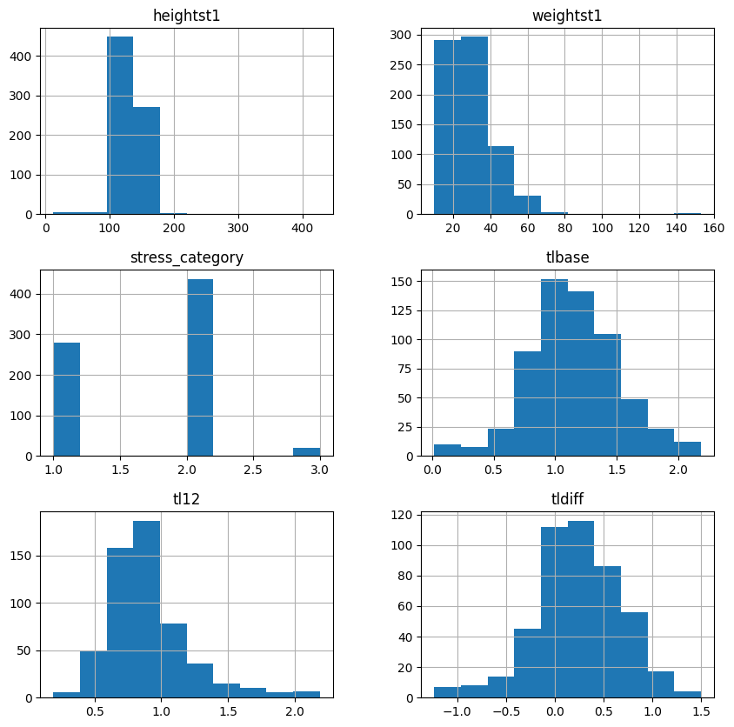
RESULTS/METHOD
Descriptive statistics
Data Size
Variables = 30
Sample size = 736
Number od duplicates
= 0
Distribution of the data
Most numerical data were skewed. This required transformations
Figure 1: Plot for numerical data

Slide 7
RESULTS/METHOD
Dataset statistics
Missing cells
= 744
Missing cells (%)
= 3.4%
Variable types
Categorical 16
Numeric 5
Boolean 9
Table 1: Missing Values Percentage

Slide 8
RESULTS/METHOD
Dataset statistics
Imbalanced data (Alerts)
= 12 variables
Note: This shaped the decision to use F1 score as the best evaluation metrics
Table 1: Imbalanced variables Percentage

Slide 9
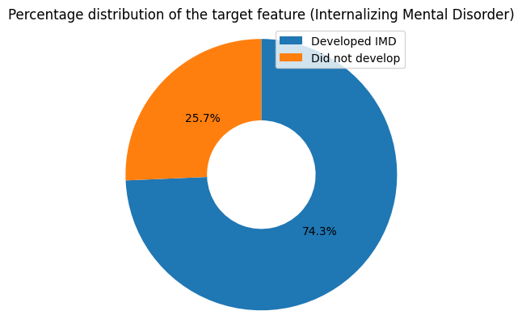
RESULTS/METHOD
Target
The prevalence of IMD was 74.3%
Handling missing values
Categorical variables: Mode
Numerical variables: Mean

Slide 10
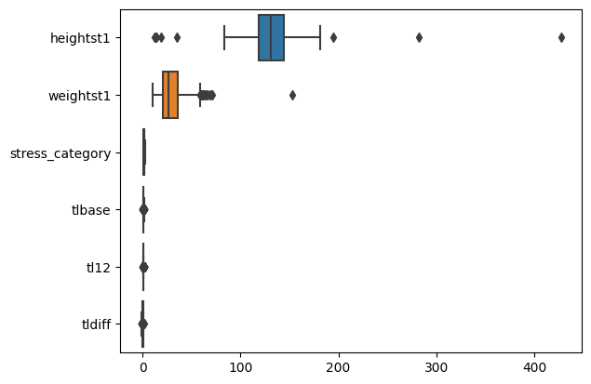
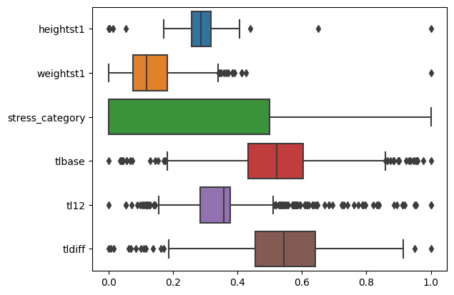
TRANSFORMATIONS
Label encoding categorical variables
Scaling (MinMaxScaler) of numerical data to limit outliers
Before scaling
After scaling

Slide 11
TRANSFORMATIONS
Pandas profile report after transformation indicated high correlation between some variables.
Also, some variables were still imbalanced.
Note: Non other steps were taken after here as these were vital variables
Table for Highly Correlated Fields

Slide 12
MODEL SPOT-CHECKING
Models spot checked included:
- Logistic Regression
- Naive Bayes
- K-Nearest Neighbours
- Support Vector Machines - Support Vector Classifier
- Decision Trees
- Ensemble classifiers (Random Forests, Gradient Boosting Classifier and AdaBoostClassifier)
The chosen evaluation metric was:
`f1-score`.
However, other metrics:
precision`
`recall`
roc_auc`
Were also employed to do model spot checking

Slide 13
MODEL SPOT-CHECKING
Using F1 Score, the best model at spot check was Linear Discriminant Analysis, but for precision, logistic regression was the best
Table: Performance of each model in the analysis during spot checking.

Slide 14
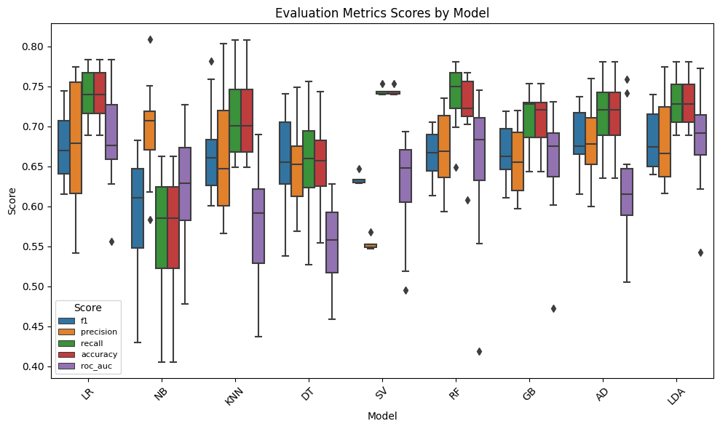
MODEL SPOT-CHECKING

Slide 15
IMPROVING ACCURACY
Hyperparameter tuning
Used to optimize the performance of machine learning models by searching for the best set of hyperparameters.
Hyperparameters are settings that are not learned from the data but are set prior to training.
E.g: Regularization strength in logistic regression, the depth of a decision tree, or the number of trees in a random forest.

Slide 16
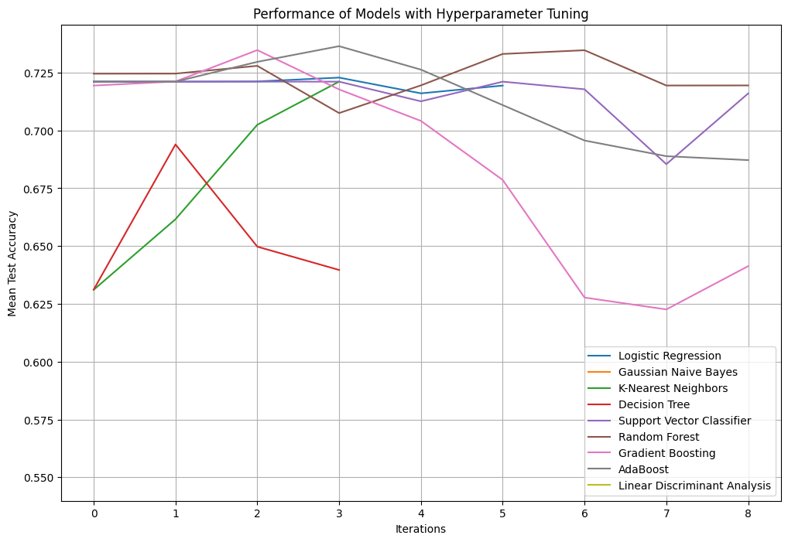
IMPROVING ACCURACY

Slide 17
IMPROVING ACCURACY
Choosing best Model
When F1 or Accuracy was used to choose the best Model after hyper parameter tuning:
Best Model Selected: AdaBoost
Accuracy: 0.736
F1 Score: 0.8345
Table: Model performance after hyperparamter tuning

Slide 18
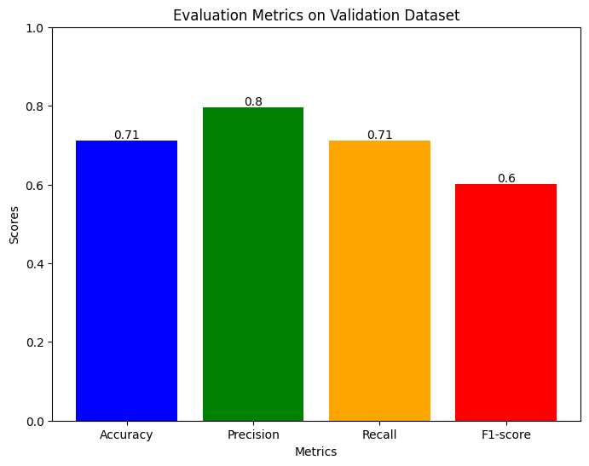
PERFORMANCE ON UNSEEN DATA
AdaBoost's performance on unseen data, as evaluated on the validation dataset:
Accuracy: 71.17%
Precision: 79.56%
Recall: 71.17%
F1-score: 60.06%
This indicates a balanced performance across multiple evaluation metrics for AdaBoost on the validation dataset.

Slide 19
FEATURE IMPORTANCE
Feature importance is a technique used to understand which features have the most impact on a model's predictions.
stress_category: Most influential feature
weightst1: Weight at the start of the study closely follows
childeduc1: Child's education level ranked third
tlbase & religion1: Baseline telomere length and religion equally contribute, highlighting their significance.
heightst1: Height at the start of the study also holds moderate importance.

Slide 20
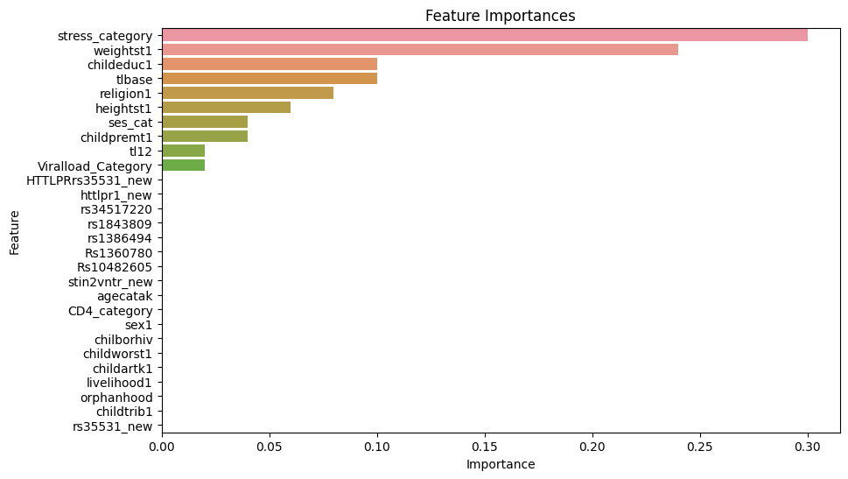
FEATURE IMPORTANCE

Slide 21
CONCLUSION
The study analyzed various machine learning models with AdaBoost emerging as the top performer based on overall performance metrics.
AdaBoost demonstrated strong accuracy, precision, recall, and F1-score on both training and validation datasets
This showcased its effectiveness in handling the given data.
Through analysis, it was revealed that stress levels, initial weight, child's education, baseline telomere length, and religious affiliation significantly impact the IMD in Children and Adolescents with HIV.

Slide 22
THE END

